Slide 1
BITCOIN: First Implementation of Blockchain
2

Slide 2
Bitcoin – The Beginning
“A decentralized digital currency enables instant payments to anyone, anywhere in the world” – en.bitcoin.it
Value of Bitcoin=?
No central authority, uses peer-to-peer technology
Two broad operations
Transaction Management – transfer of bitcoins from one user to another
Money Issuance – regulate the monetary base

Slide 3
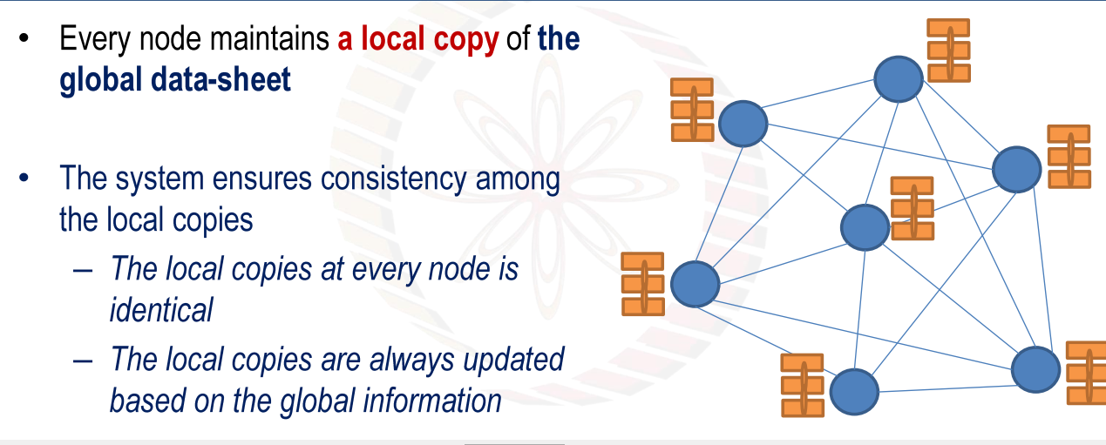

Slide 4
Bitcoin Basics – Creation of Coins
Controlled Supply: Must be limited for the currency to have value – any maliciously generated currency needs to be rejected by the network
Bitcoins are generated during the mining – each time a user discovers a new block
The rate of block creation is adjusted every 2016 blocks to aim for a constant two week adjustment period

Slide 5
Bitcoin Rewards
2009- 2012: 50 BTC
2012- 2016: 25 BTC
2016-2020: 12.50 BTC
2020-2024:6.25 BTC
2024-2028: 3.125
A new block is created for every 10 Minutes (Avg)
6 Blocks(in 1 hour)*24(hours/day)=144 blocks/day
144*14(days/2 wees)= 2016 blocks for every two weeks

Slide 6
Bitcoin Basics – Creation of Coins
The number of bitcoins generated per block is set to decrease geometrically, with a 50% reduction for every 210,000 blocks, or approximately 4 years
This reduces, with time, the amount of bitcoins generated per block
Theoretical limit for total bitcoins: Slightly less than 21 million
Miners will get less reward as time progresses
How to pay the mining fee – increase the transaction fee

Slide 7
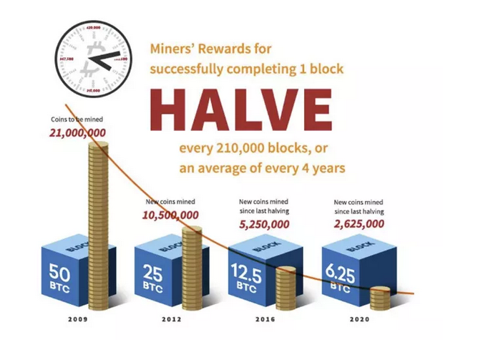

Slide 8
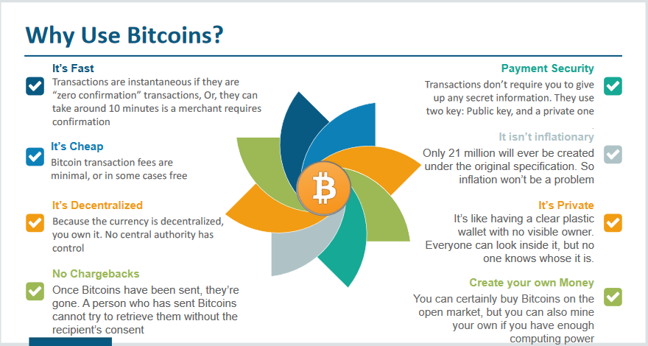

Slide 9
Bitcoin Wallets:
coinbase.com,
wazirx,
binance,
bitcoinwallet.com,
mycelium (mobile client)
Blockchain.com
Zebpay

Slide 10
Bitcoin Basics – Sending Payments
Need to ensure that Eve cannot spend Alice’s bitcoins by creating transactions in her name.
Bitcoin uses public key cryptography to make and verify digital signatures.
Each person has one or more addresses each with an associated pair of public and private keys (may hold in the bitcoin wallet)

Slide 11


Bitcoin Basics – Sending Payments
Alice wish to transfer some bitcoin to Bob.
Alice can sign a transaction with her private key
Anyone can validate the transaction with Alice’s public key
^{T}(A->B)^{, S}A^{(T}(A->B)⁾

Slide 12
Bitcoin Basics – Sending Payments
Alice wants to send bitcoin to Bob
Bob sends his address to Alice
Alice adds Bob’s address and the amount of bitcoins to transfer in a “transaction” message
Alice signs the transaction with her private key, and announces her public key for signature verification
Alice broadcasts the transaction on the Bitcoin network for all to see

Slide 13
Bitcoin Anonymity
Bitcoin is permission-less.
The public and the private keys do not need to be registered, the wallet can generate them for the users
The bitcoin address is used for transaction, not the user name or identity

Slide 14
Bitcoin Anonymity
A bitcoin address mathematically corresponds to a public key based on ECDSA – the digital signature algorithm used in bitcoin
A sample bitcoin address: 1PHYrmdJ22MKbJevpb3MBNpVckjZHt89hz
Each person can have many such addresses, each with its own balance
– Difficult to know which person owns what amount

Slide 15
BITCOIN SCRIPT

Slide 16
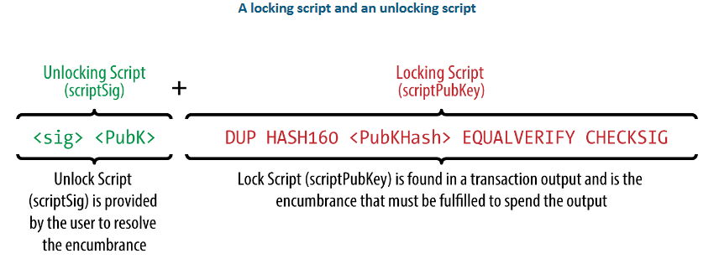

Slide 17
Bitcoin Script
Alice makes a transaction of BTC 20 to Bob. How Bob will claim those transactions?
A transaction is characterized by two parameters
Alice sends some bitcoins: the output (out) of the transaction
Bob receives some bitcoins: the input (in) of the transaction
We need to determine that a transaction input correctly claims a transaction output

Slide 18
Bitcoin Script
A programming language to validate bitcoin transactions
A list of instructions recorded with each transaction
Describes how the next person can gain access to the bitcoins, if that person wants to spend them
FORTH-like language, stack based and processed left to write

Slide 19
How FORTH Works
A stacked based computer programming language originally designed by Charles Moore
A procedural programming language without type checking
Use a stack for recursive subroutine execution
Uses reverse Polish notation (RPN) or postfix notation

Slide 20



FORTH – Sample Execution using RPN
30 10 * 15 + CR .
30

Slide 21




FORTH – Sample Execution using RPN
30 10 * 15 + CR .
10
30

Slide 22


FORTH – Sample Execution using RPN
30 10 * 15 + CR .
300

Slide 23
FORTH – Sample Execution using RPN
30 10 * 15 + CR .
15
300

Slide 24

FORTH – Sample Execution using RPN
30 10 * 15 + CR .
315

Slide 25


FORTH – Sample Execution using RPN
30 10 * 15 + CR .
315

